Slide 1
Millennium Challenge Account Nepal (MCA-Nepal)
Electricity Transmission Project (ETP)
Transmission Line
Activity
Outreach Event, New Delhi

Slide 2
Electricity Transmission Project
Outcomes:
Add 3,920 MW Tx capacity; reduce losses to 1.9%
Support 3x increase in electricity consumption per capita
Approx. 312 km – 400 kV Tx lines (~857 towers)
3 x 400 kV substations

Slide 3
Electricity Transmission Line Status
Transmission Line Route Alignment frozen for all five segments
Lapsiphedi ‐ Ratmate
Ratmate ‐ New Hetauda
Ratmate ‐ New Damauli
New Damauli ‐ New Butwal
New Butwal ‐ Nepal/India Border
Geotechnical survey works completed
Draft EIA document in advanced stage of preparation

Slide 4
Electricity Transmission Line Status

Slide 5
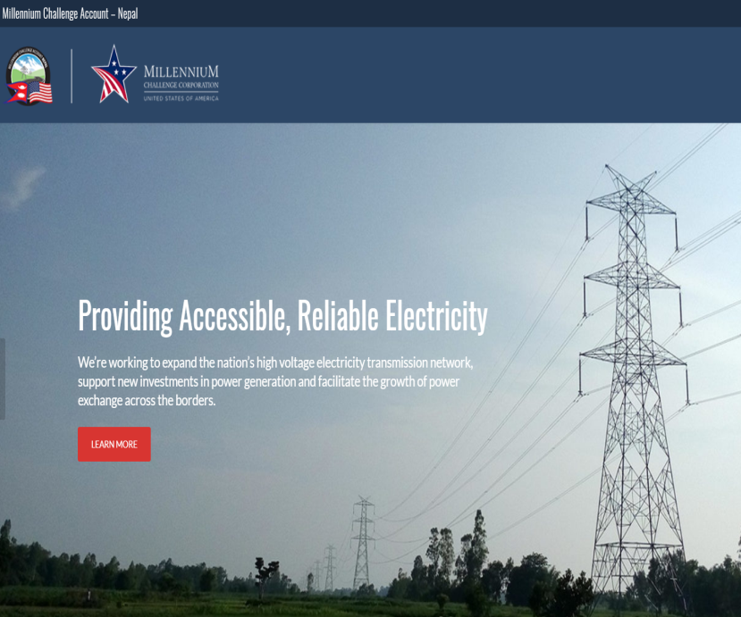
Electricity Transmission Line (Works)
Transmission Lines
400 kV D/C; lots 90-115 km each
3.5 year execution
Design-Build (FIDIC Yellow Book)
Expected launch: Jan 2020
Quality-Price Based Selection
Expected contract sign: Sep 2020

Slide 6
Segment Wise Physical Information
TL Segments | Physiographic Zone (Length Percentile) |  |  | Elevation (MASL)
 | Terai | Siwalik | Middle Mountain | Minimum | Maximum
India Border to New Butwal Substation | 100% |  |  | 100 | 120
New Butwal to New Damauli Substation | 7% | 21% | 72% | 115 | 1380
New Damauli to Ratmate Substation |  |  | 100% | 220 | 1780
Ratmate to New Hetauda Substation |  | 25% | 75% | 410 | 1840
Ratmate to Lapsiphedi Substation |  |  | 100% | 490 | 1918

Slide 7
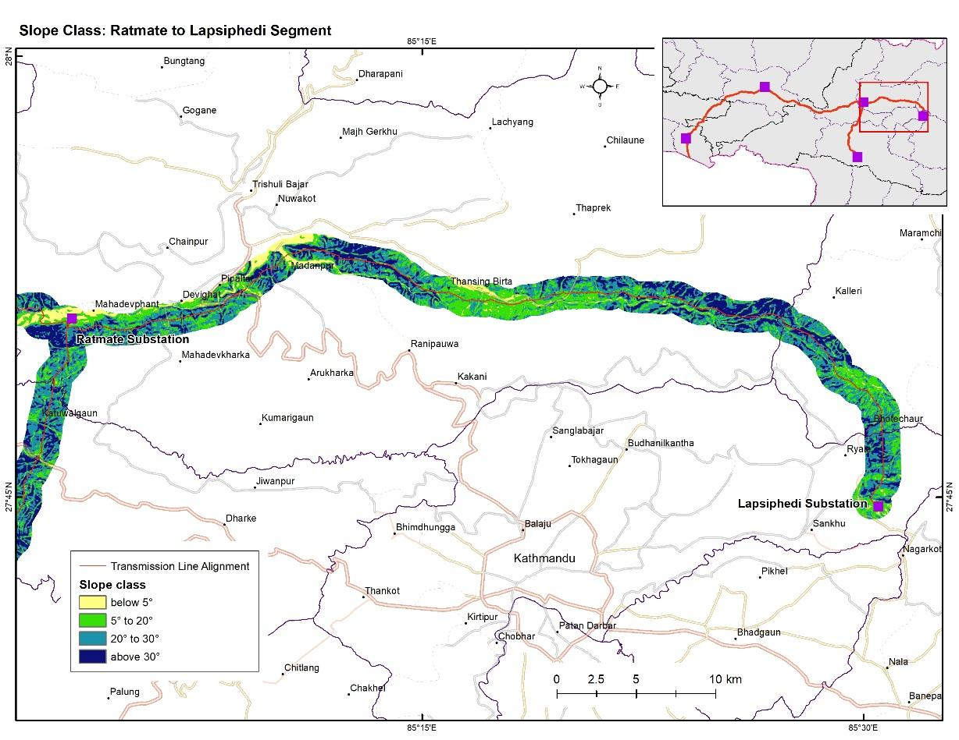
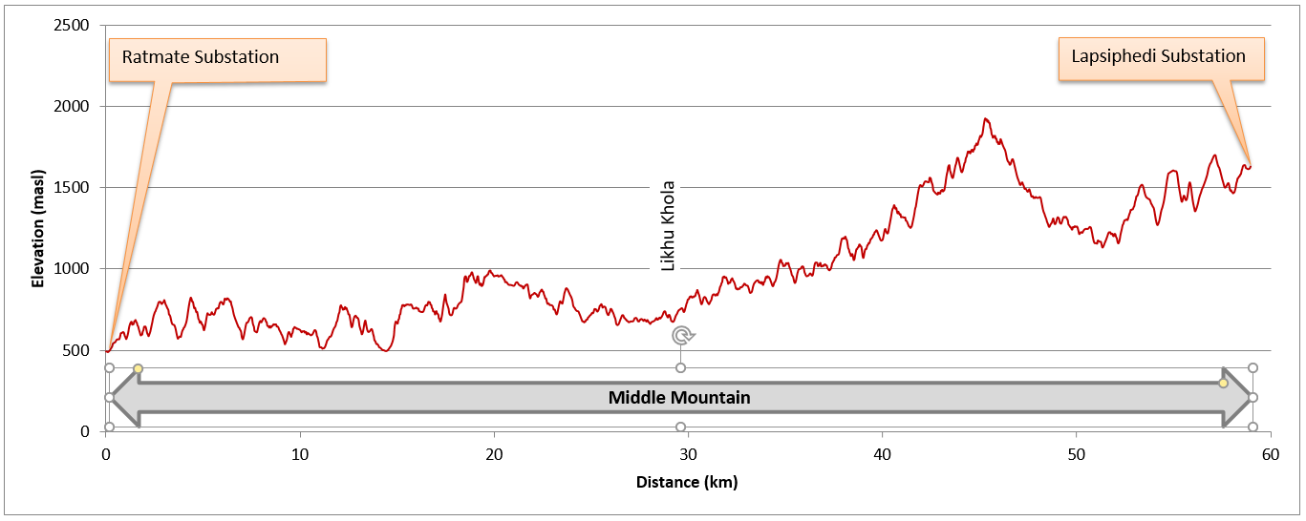
Lapsiphedi-Ratmate-New Hetauda 400kV D/C Transmission Line
Lapsiphedi – Ratmate
Middle Mountain physiographic zone (Ratmate to Lapsiphedi)
Section Length : Approx. 59 km
No. of towers: Approx. 163
400 kV Quad Moose Double Circuit

Slide 8
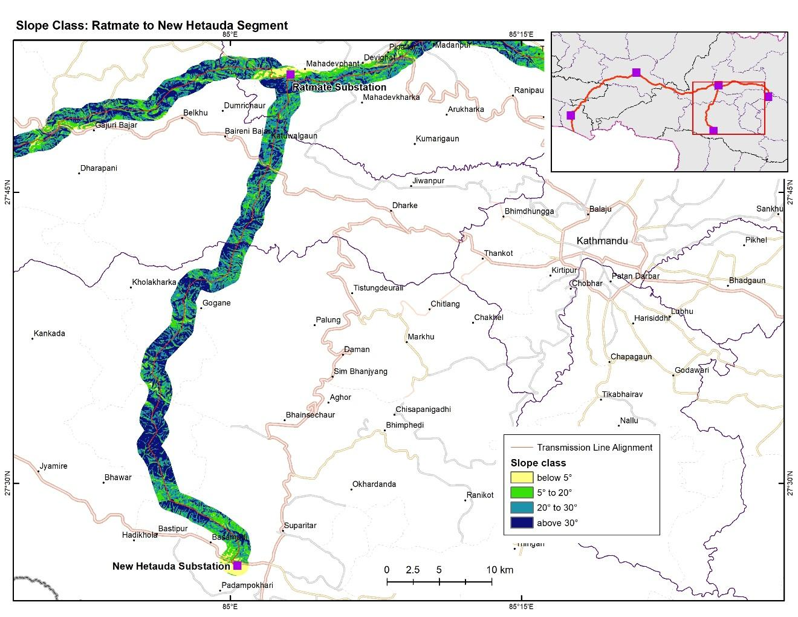
Lapsiphedi-Ratmate-New Hetauda 400kV D/C Transmission Line (contd...)
Ratmate to New Hetauda
Middle Mountain zone and partly in Siwalik zone
Section Length : Approx. 56 km
No. of towers: Approx. 142
400 kV Quad Moose Double Circuit
Possibility of few Quad Moose Quad Circuit towers

Slide 9
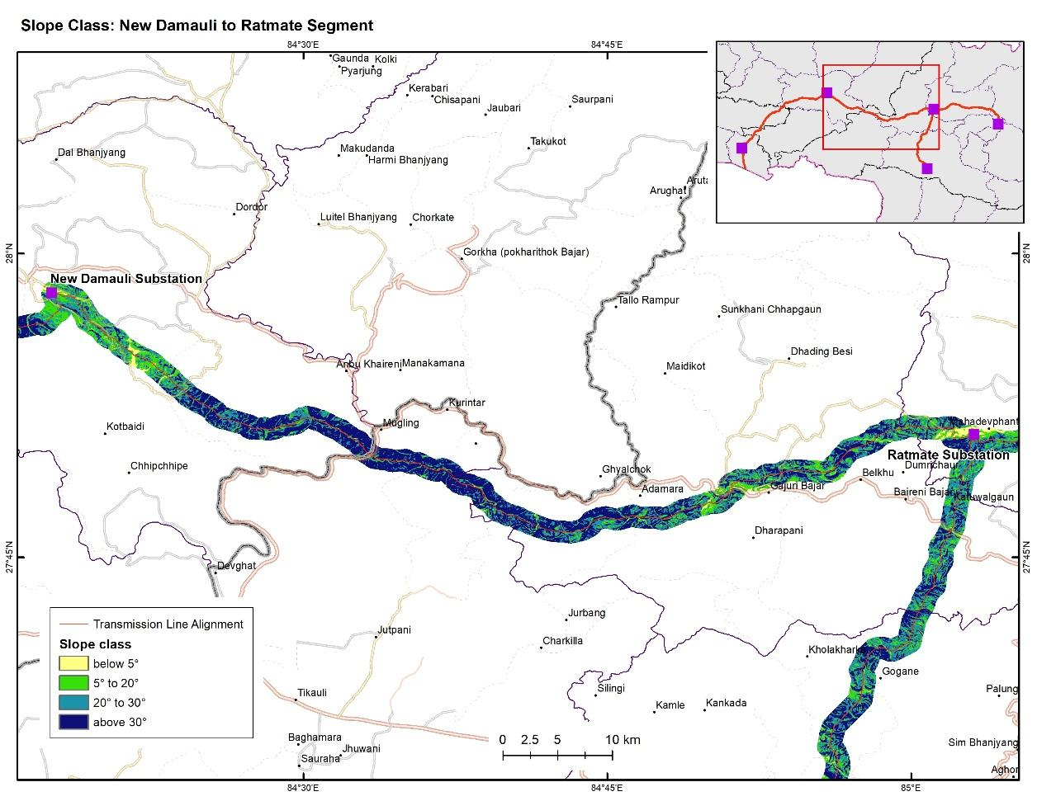
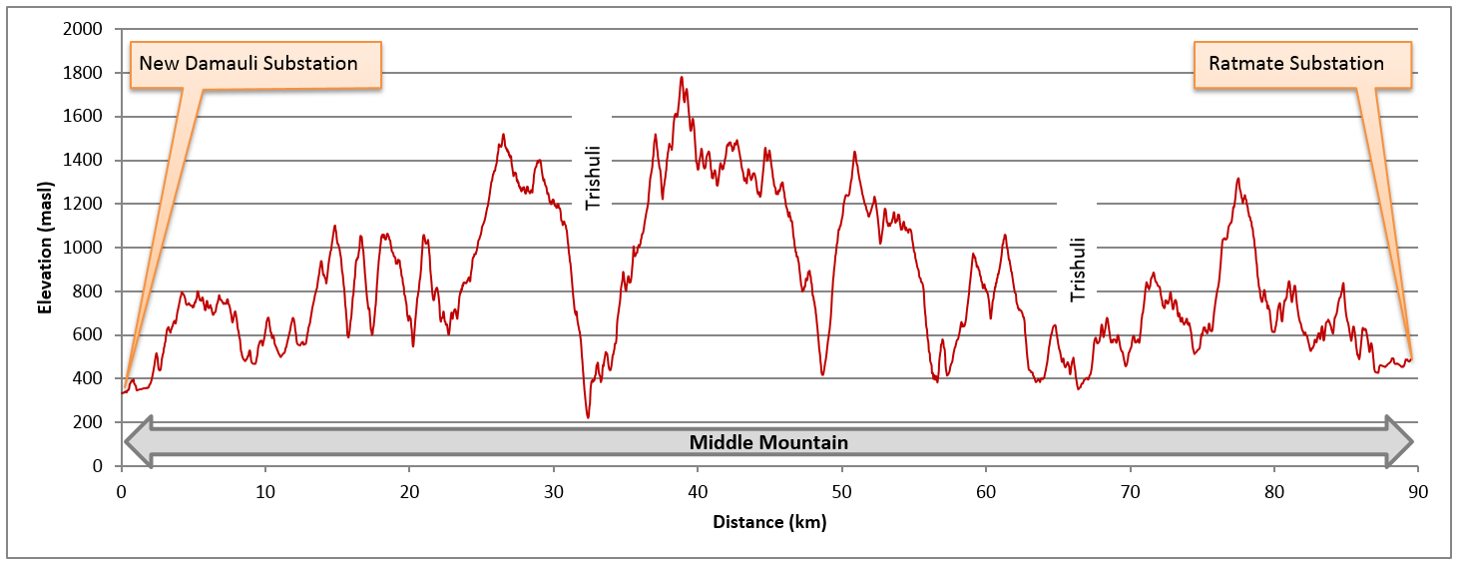
Ratmate-New Damauli 400kV D/C Transmission Line
Middle Mountain physiographic zone (Ratmate to New Damauli)
Section Length : Approx. 89 km
No. of towers: Approx. 251
400 kV Quad Moose Double Circuit

Slide 10
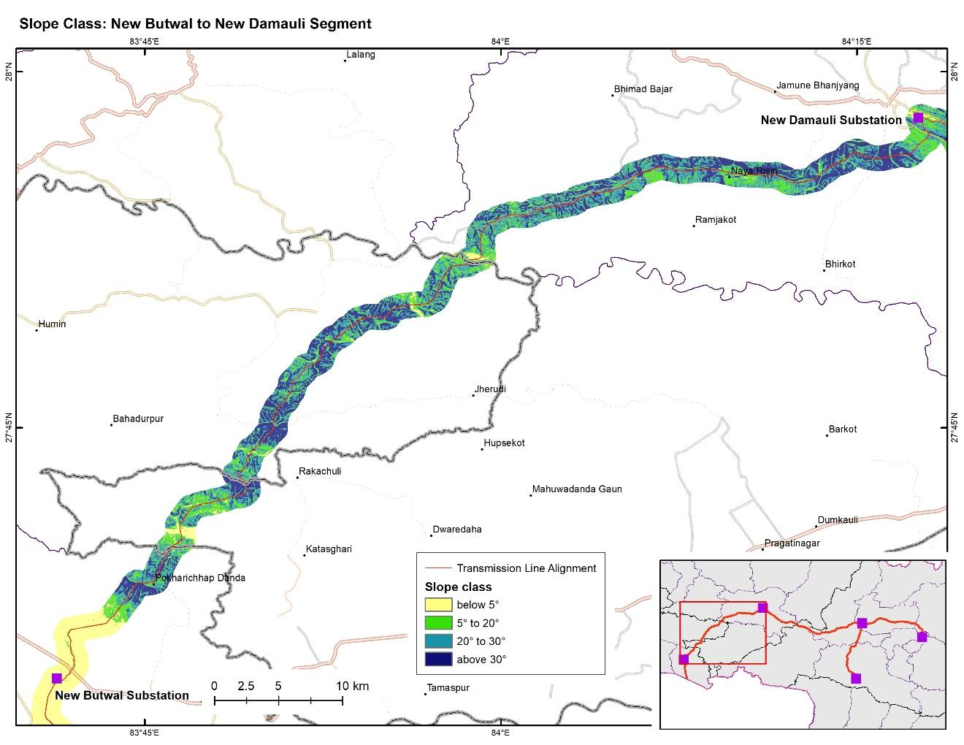
New Damauli-New Butwal-Indo Nepal Border 400kV D/C Transmission Line
New Damauli to New Butwal
Cuts across three physiographic zones - Terai, Siwalik, and Middle Mountains.
Section Length : Approx. 90 km
No. of towers: Approx. 248
400 kV Quad Moose Double Circuit
Few Quad Moose Quad Circuit towers near New Butwal substation

Slide 11
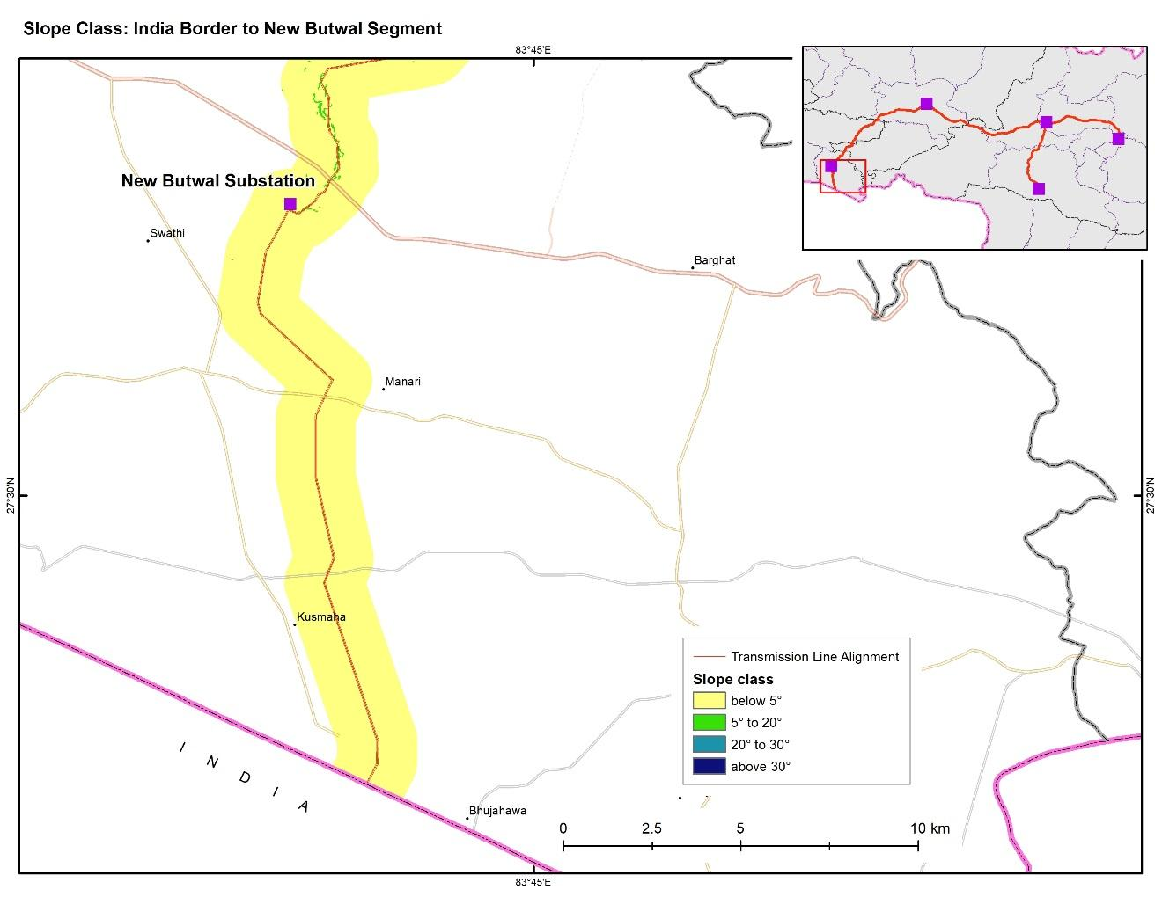
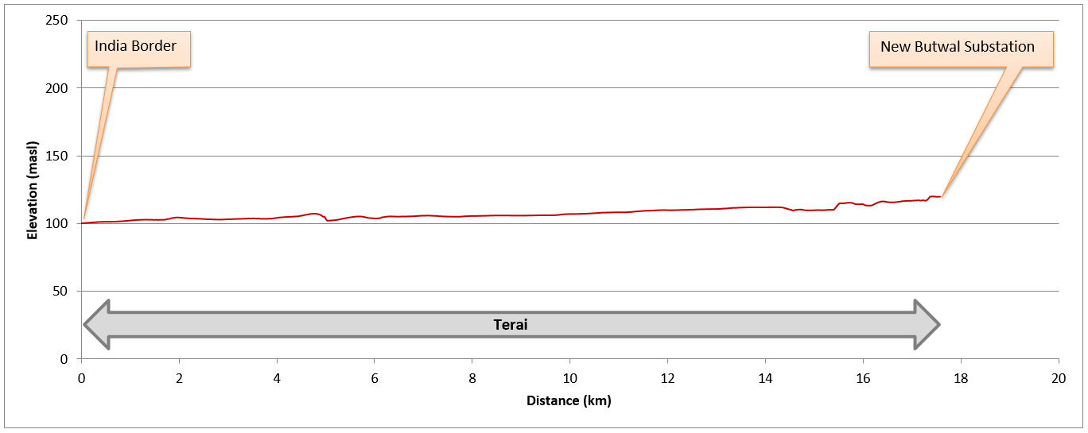
New Damauli-New Butwal-Indo Nepal Border 400kV D/C Transmission Line
New Butwal to India Border
Terai physiographic zone
Section Length : Approx. 18 km
No. of towers: Approx. 52
400 kV Quad Moose Double Circuit

Slide 12
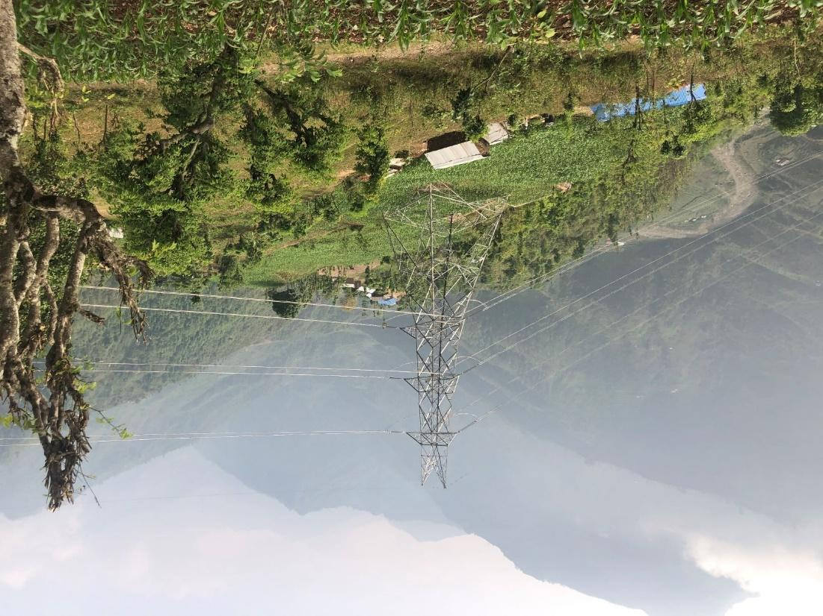
Transmission Line Towers
Probable Tower Types
Suspension
Tension (mostly)
Special Tower (for long spans)
Multi Circuit (for corridor issues)

Slide 13
Access Road Classification
Category | Width | Turn radius | Slope percent | Remarks
1 | ~5m | min. 90 ft | 0 to 15 | Generally paved or unpaved and well maintained
2 | ~3m | Min. 45 ft | 0 to 30 | Unpaved road in fair condition
3 | ~2.5m | Min. 20 ft | 0 to 45 | Unpaved narrow road in poor condition
4 | ~1.5m | Min. 15 ft | 0 to 45 | Wide trail in fair condition
5 | ~0.5m-1m | Min. 6ft | 0 to 24 | Narrow trail.
6 |  |  |  | Aerial access in the only option

Slide 14
Transmission Line Preliminary Assessment of Road Access
Length of Access Roads per Category in each Segment
Segment | Road Category (in km)
 | 1 | 2 | 3 | 4 | 5
New Butwal to India Border | 49.0 | 22.2 | 12.4 | 8.8
New Butwal to New Damauli | 216.2 | 86.0 | 115.1 | 41.1 | 45.2
New Damauli to Ratmate | 201.5 | 32.4 | 156.7 | 126.8 | 61.2
Ratmate to Lapsephedi | 21.1 | 65.6 | 97.3 | 57.3 | 25.9
Ratmate to New Hetauda | 187.6 | 96.6 | 52.9 | 29.7 | 28.5

Slide 15
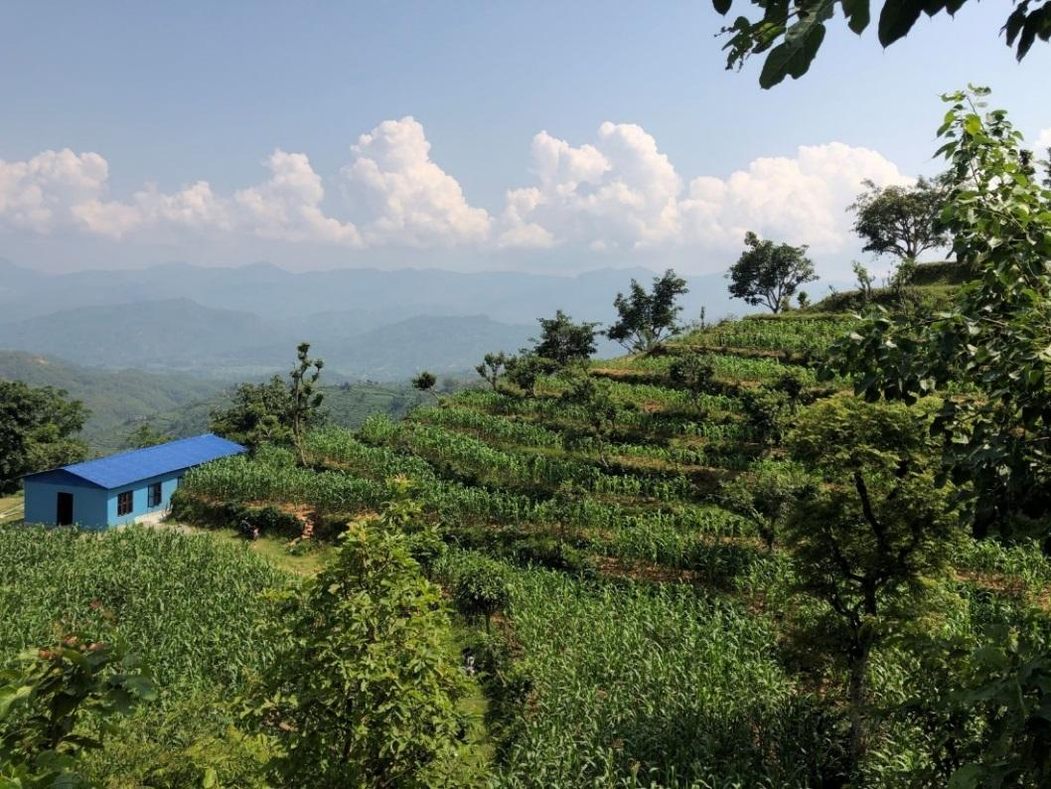
Resettlement and Land Acquisition
Resettlement policy framework completed
Entitlement Matrix completed
RAP of Transmission lines will be completed by June 2020
Land compensation payment to be completed by December 2020

Slide 16
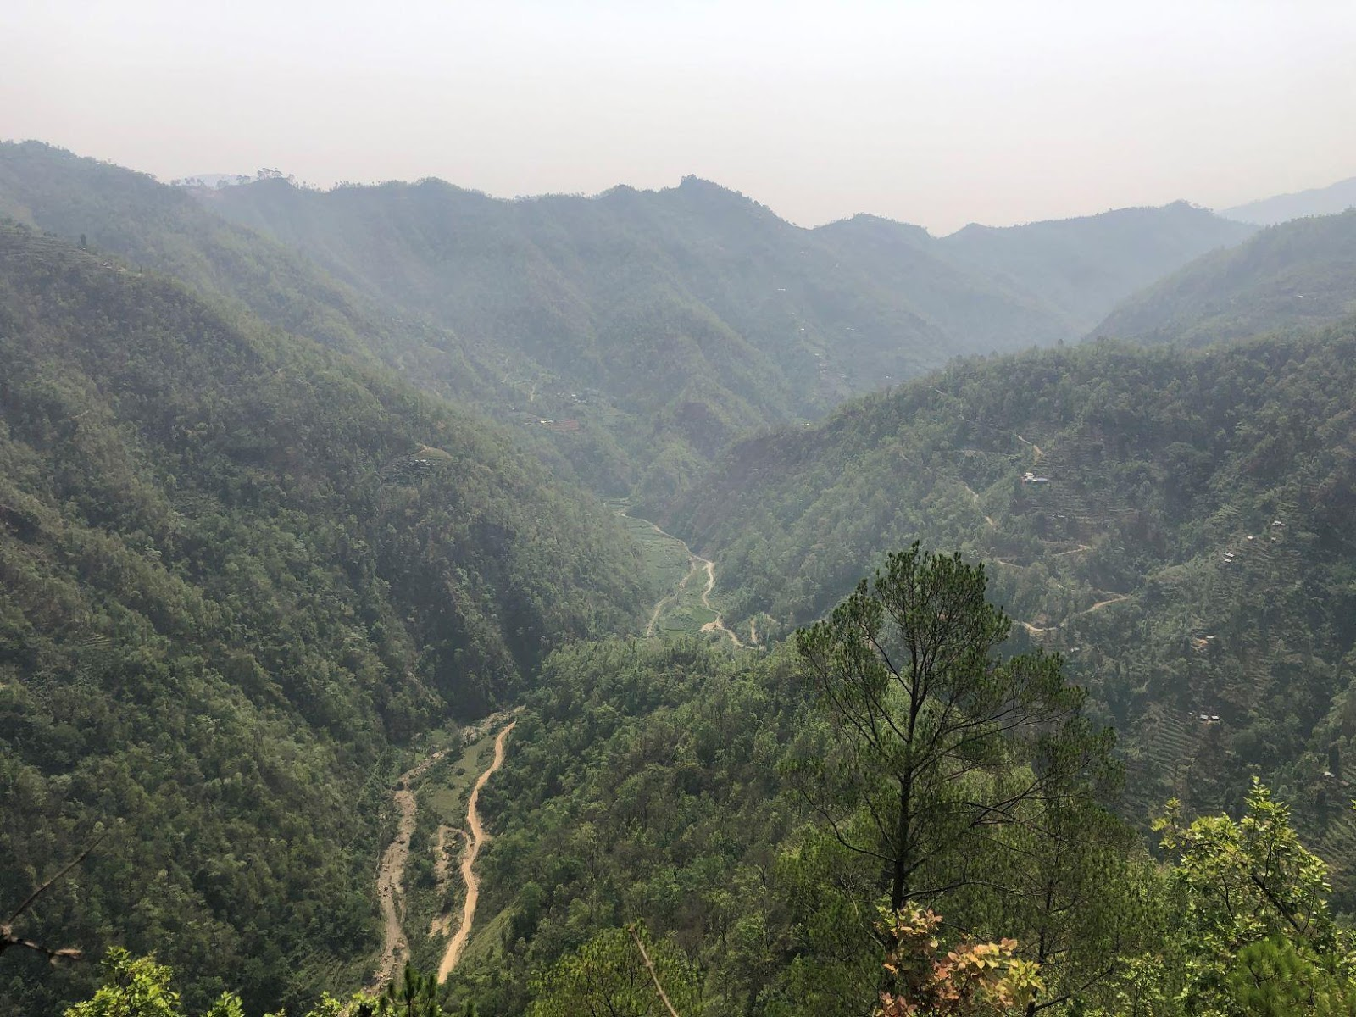
Challenges
Difficult Terrain, Transportation of materials: Elevations vary from 100 meters (330 ft.) to around 2000 meters (6563 ft.)
Land acquisition and securing right of way
Heavy monsoon season of 3 months (9 months effective in a year)
Forest clearance
Major river crossing
Trishuli
Kali Gandaki
Seti

Slide 17
Expected Timeline
Activities | 2020 |  |  |  |  |  |  |  |  |  |  |  | 21 | 22 | 23 | 24 |  | 25
 | Jan | Feb | Mar | Apr | May | Jun | Jul | Aug | Sep | Oct | Nov | Dec |  |  |  | Jun | Jul | Jun
Bid Release (in web & Newspaper)
Site visit
Pre-bid meeting
Bid Submission
Technical Bid opening
Financial Bid Opening
Award of contract
Construction Period
Defect Notification Period

Slide 18
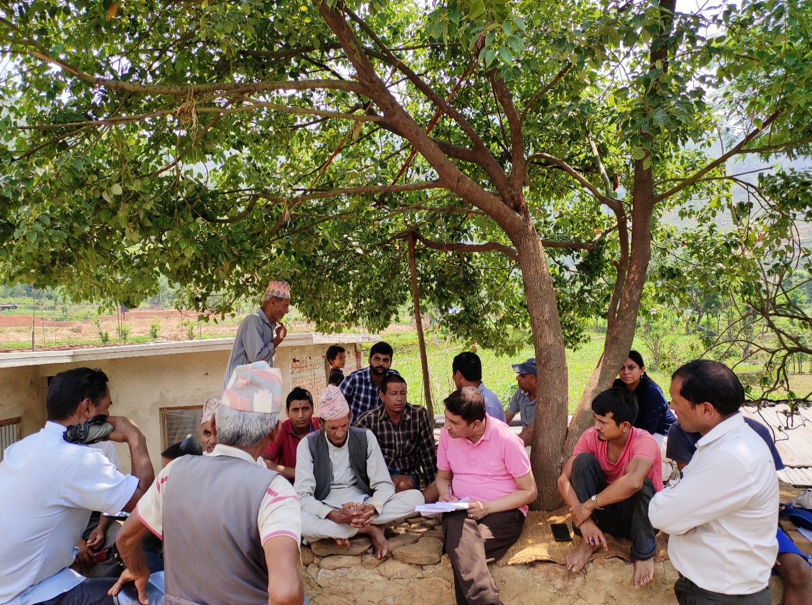
MCA Partnership program
A benefit sharing component of ETP
Intent: Benefits from infrastructure development are equitably shared with people directly and indirectly affected by the project which goes beyond compensation and mitigation measures

Slide 19
Thematic Areas
Thematic Area 1: Extension and upgrading of grid-based electricity distribution system
Thematic Area 2: Provision of off-grid electricity solutions
Thematic Area 3: Provision of capacity building support to increase benefits of electricity

Slide 20
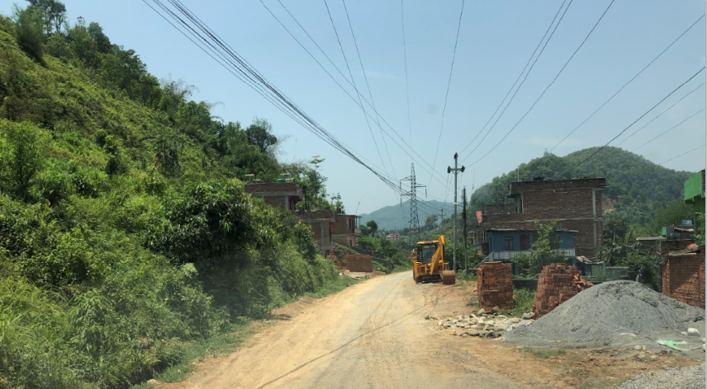
MCA Partnership program Status
Framework developed
Sub-activity consultation to be done by December 2019
Expected date for construction bid release for thematic area 1 by August 2020
Expected date for Request for proposal for Thematic area 2 and 3 by March 2020

Slide 21
Environmental and Social Issues in Transmission Line

Slide 22
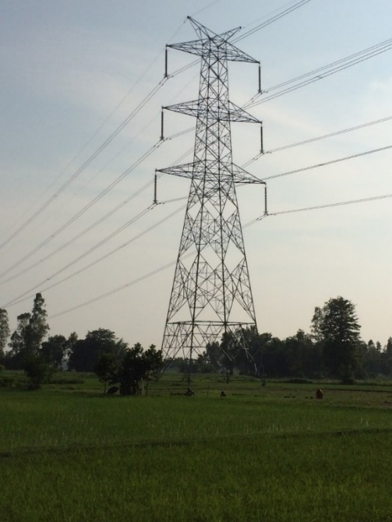
Environmental and Social Impacts of TL
Land needs to be acquired for transmission towers – private land or forest.
Restriction on the use of row land – 46m, 23m on each side.
Landslides/soil erosion
Health and safety issues
Trafficking in person

Slide 23
MCA - Nepal / MCC Policies
Follow GoN rules and regulations including Land Acquisition Act, Environment Protection Act, and Regulations, Forest Acts.
Follow MCC Environmental Guidelines and International Finance Corporation (IFC) Performance Standards on Environmental and Social Sustainability.
Follow MCC Gender Policy and Social and Gender Integration Guidelines.

Slide 24
Additional Employer’s Requirements of Note
Respect IFC Performance Standards
Gender & Social Inclusion Plan
Respect environ. & social clauses
Abide by health & safety plans
Engage with stakeholders

Slide 25
Avoidance (Examples)
Avoid biodiversity hotspots
Avoid settlements
Avoid cultural heritages

Slide 26
Minimize (Examples)
Minimize forest clearance by appropriate tower designs, use of pilot wire, drones, etc. for stringing.
Minimize the need for access roads by use of porters and other methods.

Slide 27
Mitigate (Examples)
Use of bird diverters
Reforestation
Slope stabilization/rehabilitation works

Slide 28
For more Information
MCC-funded business opportunities, please visit:
www.mcc.gov/work-with-us
For MCA-Nepal business opportunities, please visit:
www.mcanp.org
For Q&A regarding the procurement, please contact:
info@mcanp.org

Slide 29
Thank you.

